Slide 1
Organization for A- Level Global perspectives
Nadia Hayes
Period 1

Slide 2
What is A-Level Global?
Firstly it is different from paper 2 as it does not only contain 2 sides, this is a multiple perspective essay and will be formatted in that way.
In your paper 4 you will be expected to find expert sources in which you will compare their perspectives on your overall question.
This essay is 5,000 words and requires a high level of research beyond paper 2, therefore the class takes the whole year to write your essay.
Therefore the question you chose is very important, and I would recommend writing on something you are very passionate about or for example something within the field you want to purse in college.
For example I want to purse medical school to become a psychiatrist, so the question I wrote on was
“Is the misdiagnosis of mental illness a problem in the United States?”

Slide 3
Best Resources
First Cambridge’s Learning Guide will be the base of what needs to be completed to succeed in A level global. Available with the link below, this is the syllabus which is one of the most valuable resources as it is an individual studies class.
http://shshistory.com/extra%20pages/A_Learners_Guide_to_the_Cambridge_Research_Report.pdf

Slide 4
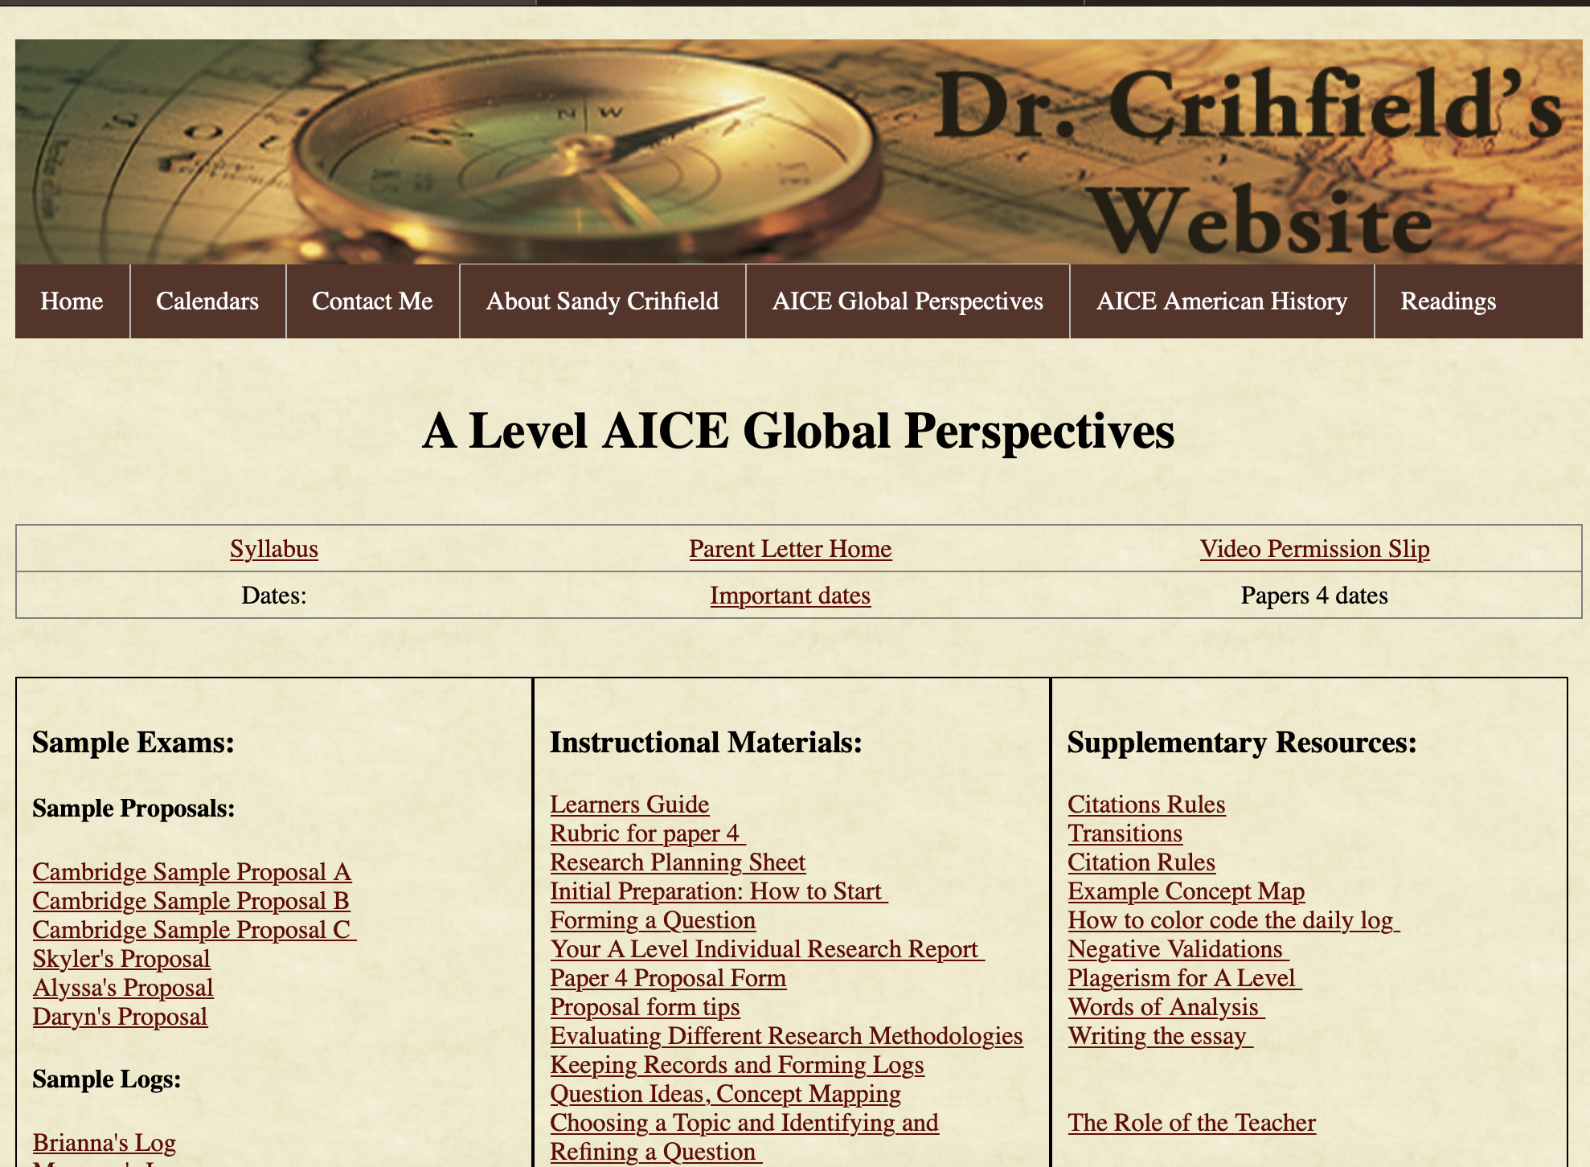
Best Resources
Further Dr. Crihfield’s website under the A Level section will have all the help you need to referrer to.
http://shshistory.com/a_global.html

Slide 5
Organization is a Priority
What you will be using to compile all of the research you collect is One-Note a Office365 application
This will include:
research and data gathered
Quotes, referenced with complete bibliographic information
Analysis pages
Reflections pages
Theories and arguments
Emerging themes
Calendar
Bibliography

Slide 6
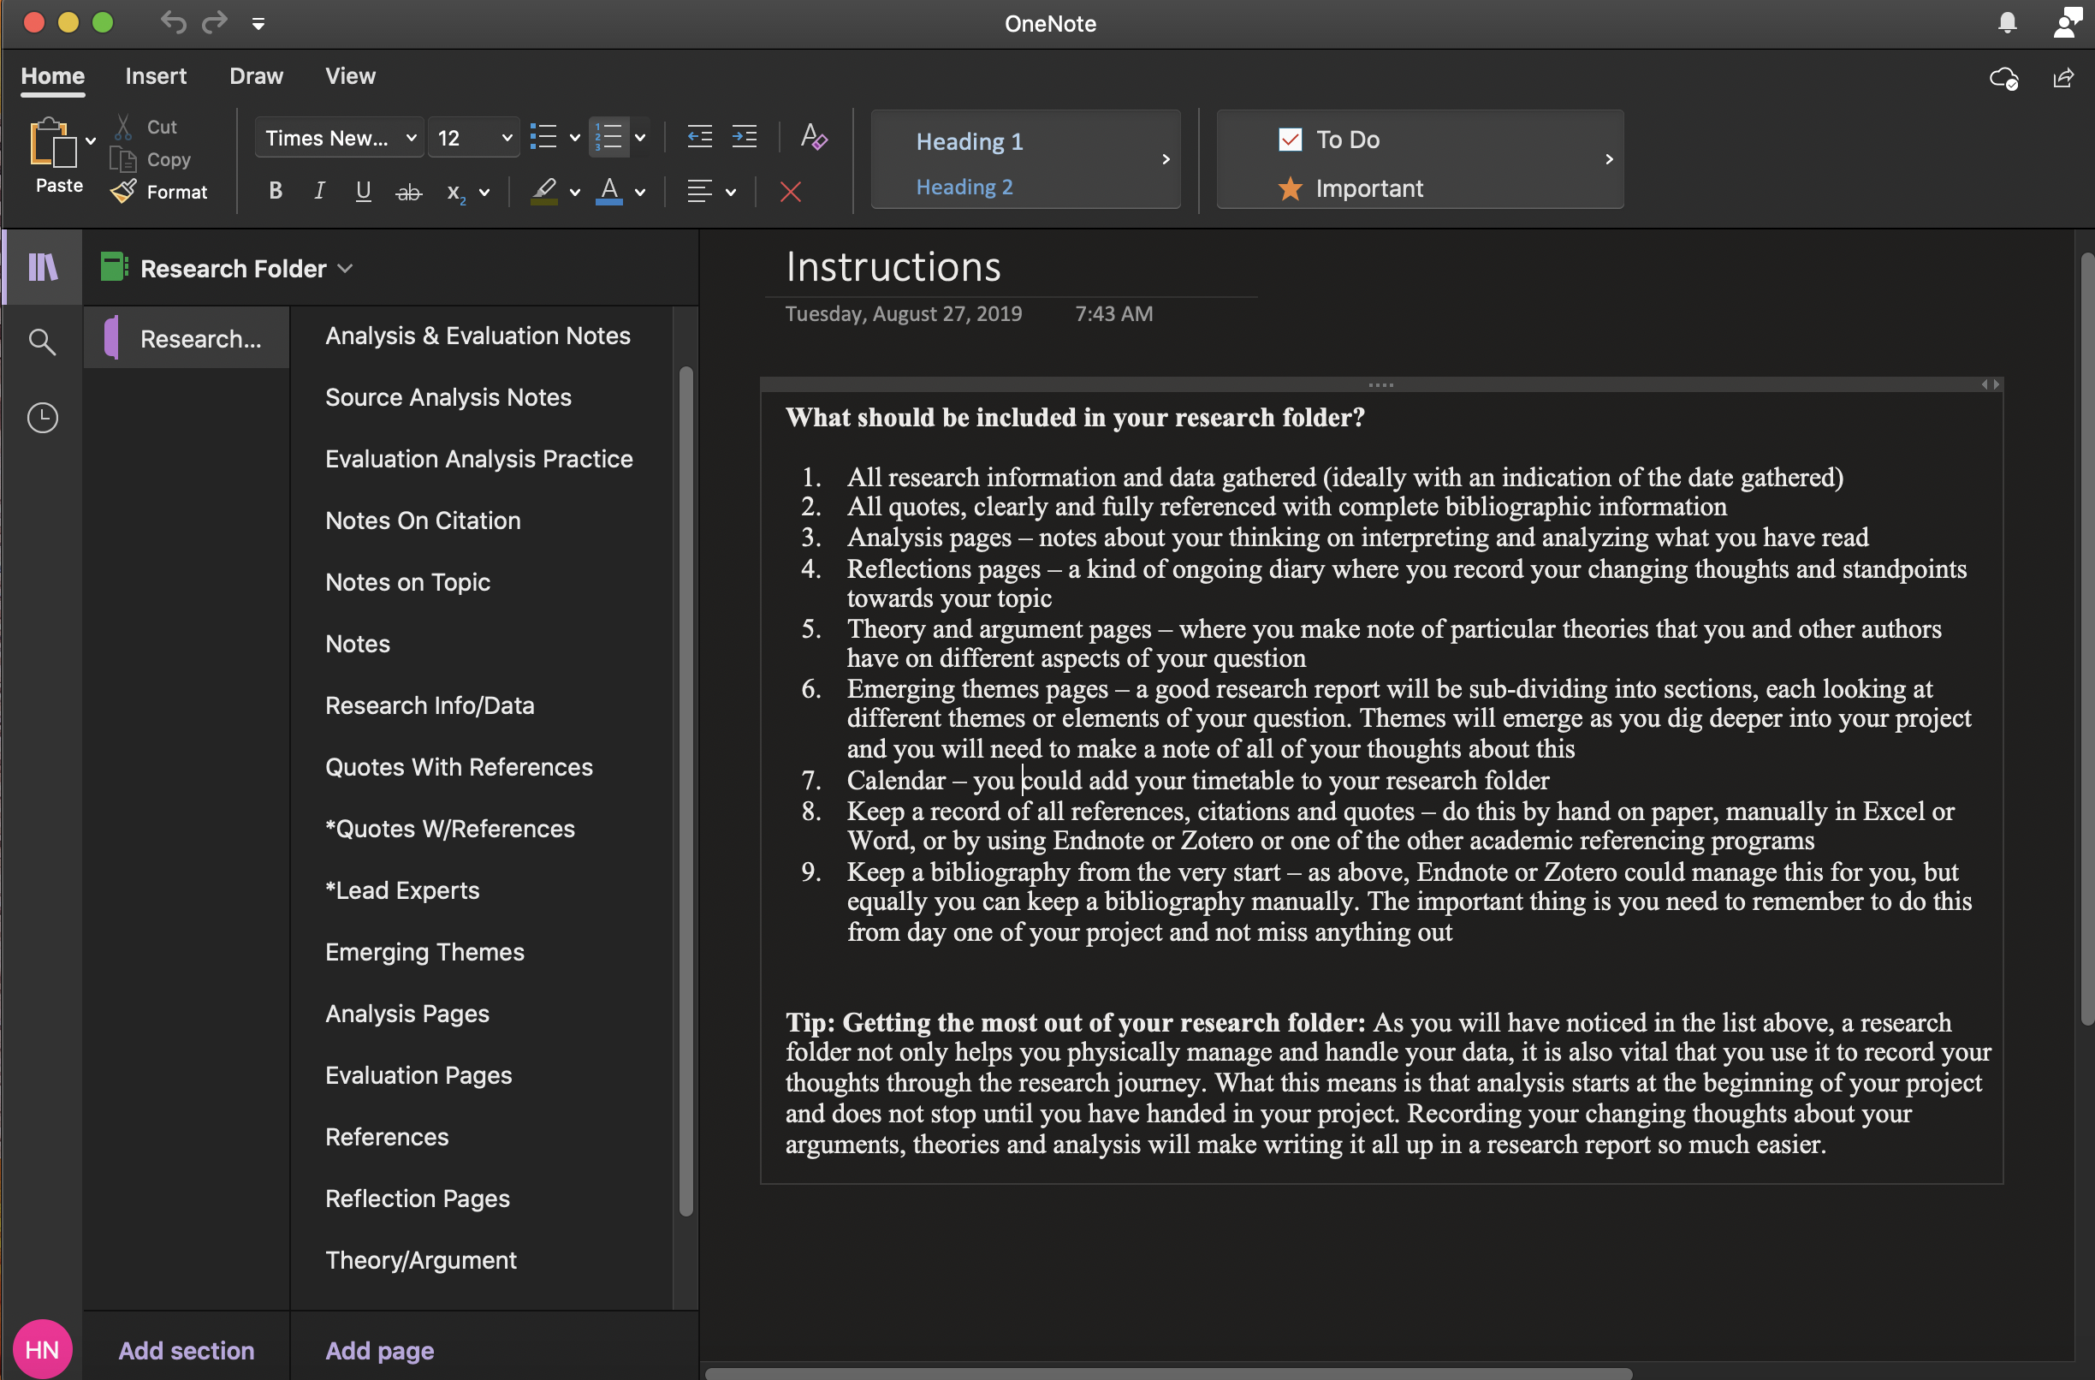
Research Folder
This is an example of what my research folder looked like to keep me organized throughout the year.
This is necessary for organization or else you will have no way to keep track of your data.

Slide 7
How to Create a Research Folder
Each tab in your folder is equally important, and the key to organization is to make sure you put the information you collect in the correct folder throughout, this makes writing your paper a lot easier.
To begin open the application and start a blank notebook, in which you will begin tabs these tabs will be labeled as followed
Instructions
Research Info/data
Quotes with References
Analysis Pages
Evaluation Pages
Reflections Pages
Theory/Arguments
Emerging Themes
Calendar
Annotated Bibliography.

Slide 8
Notebook Section Meanings
Research Info/Data Tab
Quotes With References Tab
This is similar to taking notes on your topic, this tab can include research you have found that helps you better understand how you will develop your paper.
Make sure to include the date found.
I used this tab to help me figure out how I will structure my perspectives to my question.
This will include all quotes you find that you may end up using on your paper, even if you don’t use it you need to make sure you have this information you found in the folder.
Make sure it is fully referenced with complete bibliographic information

Slide 9
Notebook Section Meanings
Analysis Tab
Evaluation Tab
This can include examples of analysis and practice analysis with your quotes you have gathered.
This will help you later with your paper as you already have quotes analyzed.
Analysis is taking an idea or quote apart.
Same as analysis tab except done with your evaluation.
Make sure to practice these as needed as they are an essential part of your paper
Evaluation is taking all of that and creating a new idea or thought and relating it to your overall question
If you need help on how to write these make sure to refer to Dr. Crihfield’s website.

Slide 10
Notebook Section Meanings
Reflection Tab
Theories and Arguments Tab
This is an ongoing diary where you record your changing thoughts and standpoints towards your topic.
This is very helpful in keeping ideas you have to further your research.
This is similar to daily logs which I will go over.
This is used to find your main experts on your question, and to collect their theories and arguments.
Make sure to do this as it shapes your final paper.

Slide 11
Notebook Section Meanings
Emerging Themes Tab
Annotated Bibliography Tab
This can help you in sub-dividing aspects of your question.
Themes will emerge as you dig deeper into your research and you will need to take notes of all your thoughts about these concepts.
You need to keep an annotated bibliography from the beginning, so you do not lose any of your research you gather throughout the year.
This also helps with the final paper as you have already completed your bibliography.

Slide 12
Research Folder
As you go about your year what is required of these tabs will begin to make more sense. However make sure you do not fall behind because this will impact your overall performance on your final paper. As well Dr. Crihfield will be checking your research folder to make sure you are on track for success.
To get a more in-depth explanation of how to set up your research folder use this link
http://shshistory.com/extra%20pages/GP%20Project%20-%20Caroline.pdf
To Success

Slide 13
TIME MANAGEMENT
This is very essential to the class, as this class is independent research you may not feel motivated to stay on track and work at a successful pace. This will cause you to fall behind quickly. Another problem many may face is that you only want to do your work in the 45 minutes you have in class, this is not possible, you will be expected to do work outside of school.
However with proper time management skills this class will be easy.
While you may have a lot of homework for other classes you should dedicate at least 25 minutes additional to your time in class for research, and when you have an upcoming assignment to complete make sure to dedicate enough time each day to complete it. Do not leave this class to the last minute as it is very in depth and requires time for a successful paper.

Slide 14
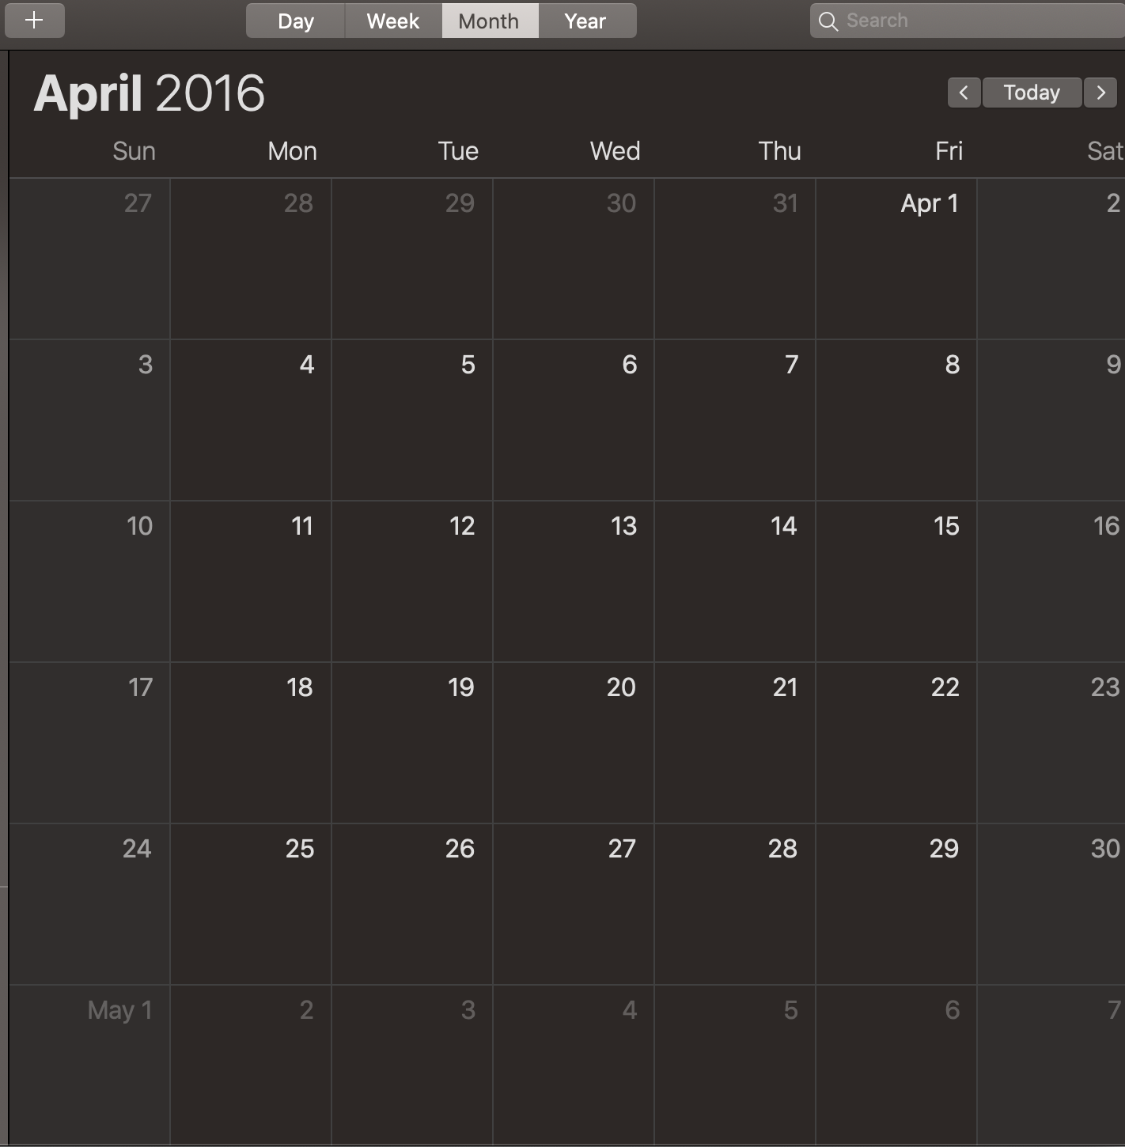
Calendar Section
A part of your research folder is the calendar you are expected to keep this up to date to keep you on top of your assignments.
You may organize this in list format however I found it easier to accomplish this by placing my iPhone’s Calendar in the section, this way I could keep track of what I want to accomplish each day for Global Perspectives and be aware of any outside of school activities I have.

Slide 15
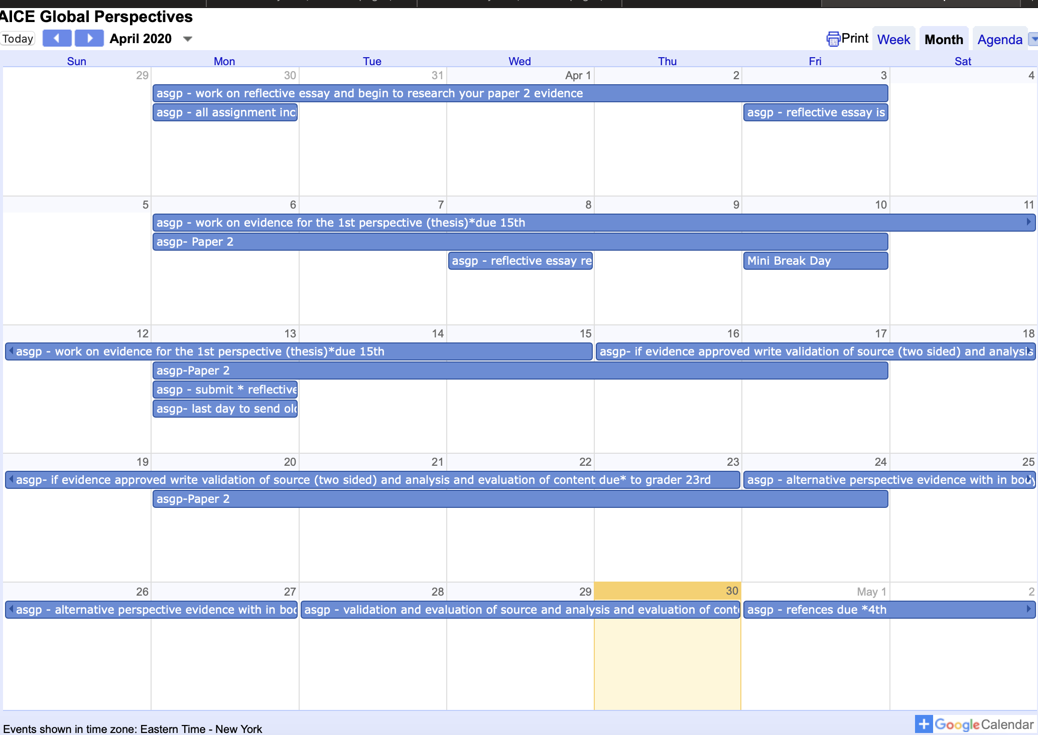
Dr. Crihfield’s Calendar
Creating a calendar will be easy as you also have access to Dr. Crihfield’s calendar online at this link
https://calendar.google.com/calendar/embed?src=scrihfield72%40verizon.net&ctz=America/New_York
This calendar will include all your upcoming tasks to complete and due dates, make sure to add all of the things posted on this calendar on your own calendar on One Note.
Example

Slide 16
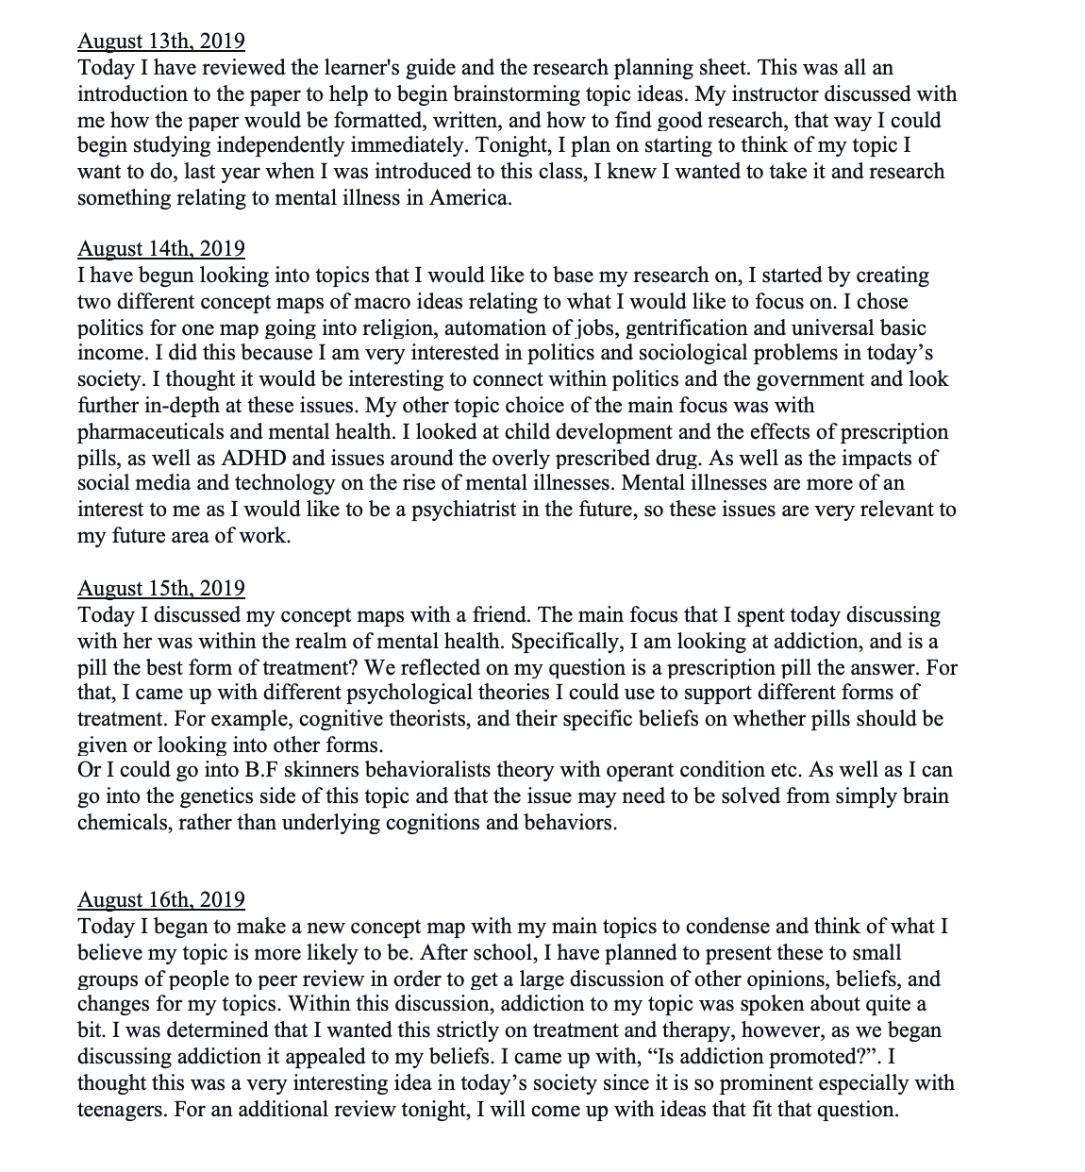
Daily Logs
Example of my logs
This is a required additional assignment to your final paper, these must be summitted to Cambridge.
A daily log is something you will be required to do daily, in which you will explain what you did that day to further work on your paper. You can include research you found interesting and would like to further your knowledge on or issues you found within your research.
You can complete your logs on One Note or Word. I found word easier to use for the logs.
This is what Cambridge requires in your log.
Devise and develop an appropriate research question.
Design and manage own research project using appropriate research methods and methodology.
Maintain and use a research log in support of the research process

Slide 17
Organization of the Paper
This paper includes a large amount of freedom to structure the paper how you desire as long as it hits all points on the syllabus necessary.
You can break your paper into three perspectives to look at within
For example, my question “Is the misdiagnosis of mental illness a problem in the United States?”
I broke this down into three aspects to look at
Economic
Medical
Social
Of course everyone's is different so as you compile research keep this in mind.

Slide 18
Mark scheme

Slide 19
Syllabus
Now that you know how to organize your independent research for A level global perspective you are ready to begin. The link to Cambridge's syllabus is at the bottom of the page.
As long as you follow all things noted within this PowerPoint this class will not be difficult, and rather this class is a great way to expose you to what college will be like. Stay on track and don’t be stressed.
Good luck!
https://www.cambridgeinternational.org/Images/414971-2020-2021-syllabus.pdf

